Slide 1

H
Walchand Institute of Technology, Solapur
S
Final Year Project Synopsis On:
HARDSECNET
By : Rahul Nawale(4)
Tushar Satpute(5)
Siddharth Magdum(6)
Under the Guidance of:
Dr. Mrs. R. M. Shelke

Slide 2
ABSTRACT
• Growing complexity of IT systems in enterprises and academia.
• Security inconsistency across Linux and Windows platforms.
• HardSecNet: unified auditing, hardening, monitoring and AI Tool.
• Features React dashboard, GPT-based analysis, and drift engine.

Slide 3
PROBLEM STATEMENT
• Cross-platform security inconsistencies.
• Manual audits prone to error and inefficiency.
• Unclear alert messages and no intelligent recommendations.
• No configuration drift detection or unified dashboard.

Slide 4
OBJECTIVES
1
2
3
Develop a unified auditing and hardening system compatible with both Linux and Windows platforms.
Leverage GPT-based AI to generate human-readable security reports and recommendations
Design a React-based dashboard for real-time visualization of audit results and system health.
4
5
Implement snapshot-based comparison to identify and alert unauthorized or unintended system changes.
Ensure each module (audit, hardening, monitoring, explainability) works independently yet integrates seamlessly.

Slide 5








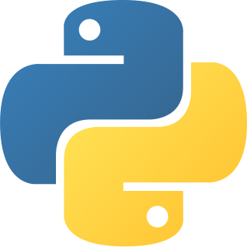
TECHNOLOGY STACK
Frontend:
React.js (UI), Axios (API calls), Chart.js (visualization), Tailwind (styling)
Dev/Test:
GitHub , Postman (API testing)
Hosting: Firebase, Vercel
Backend:
Flask (Python REST API), JSON/File Storage (audit logs, snapshots)
OpenAI API (GPT integration)
Client Tools:
Linux: Bash scripts, Lynis, Ansible, iptables, systemctl
Windows: PowerShell scripts, auditpol, registry, GPOs

Slide 6
PROCESS
1
2
3
4
5
Requirement Gathering & Use Case Design
Technology Stack Finalization
Module Development
Testing
Deployment & Monitoring
OS Hardening Scripts (Linux & Windows)
Flask API Backend
GPT Explainability Engine
Drift Detection System
React Monitoring Dashboard
Unit, integration, and UAT across OS environments.
Launch on cloud/local systems with dashboard integration and live monitoring.
Identify target systems, audit goals, and real-world security gaps.
Choose tools and frameworks

Slide 7
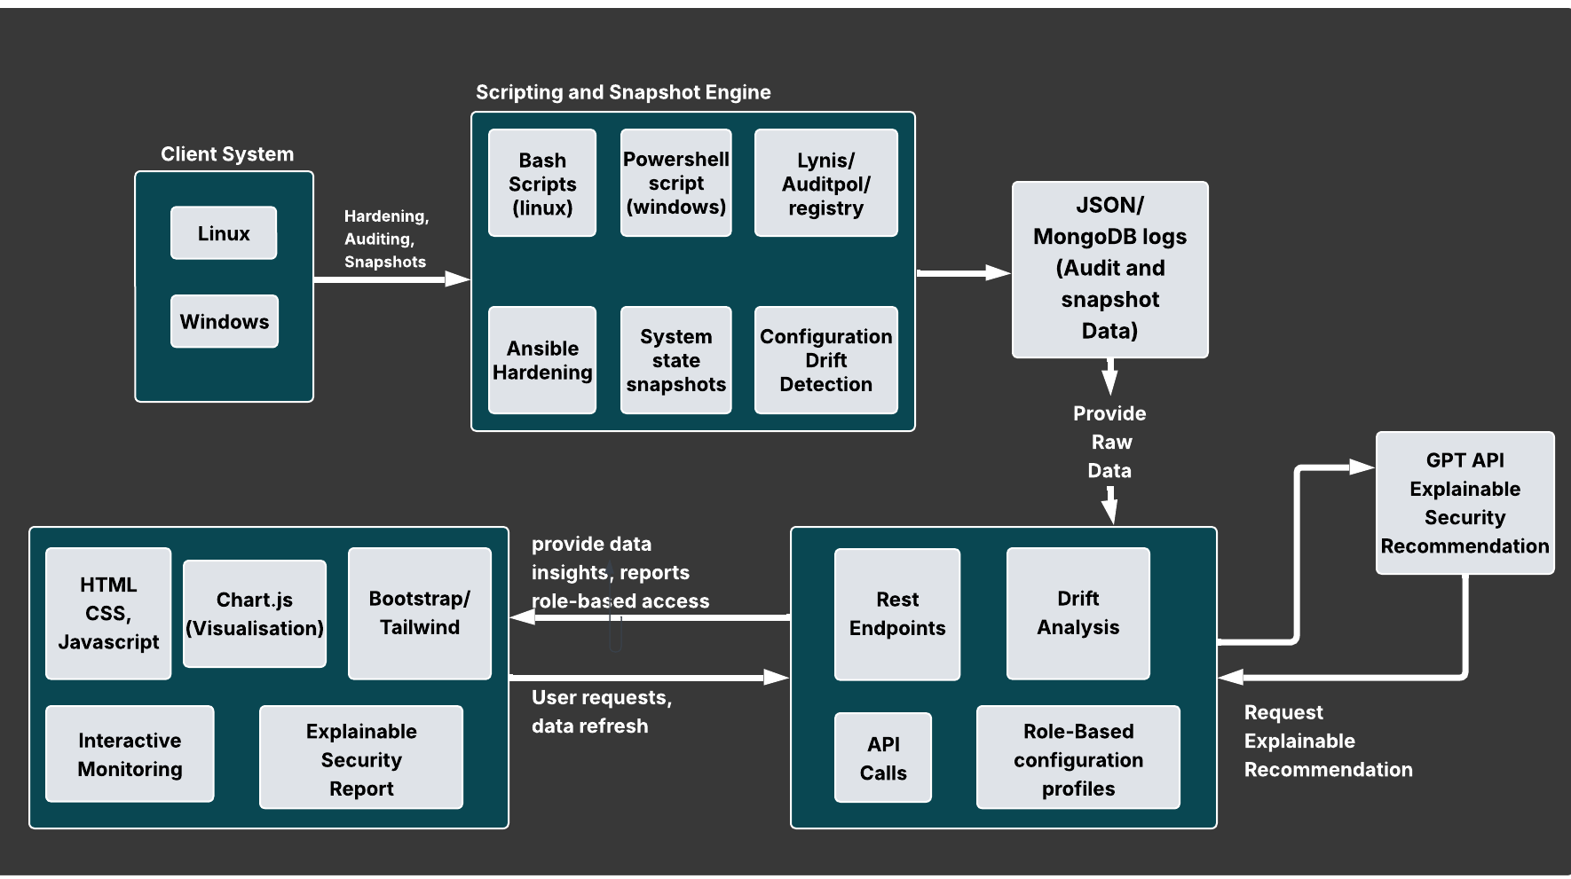
ARCHITECTURE
DIAGRAM

Slide 8
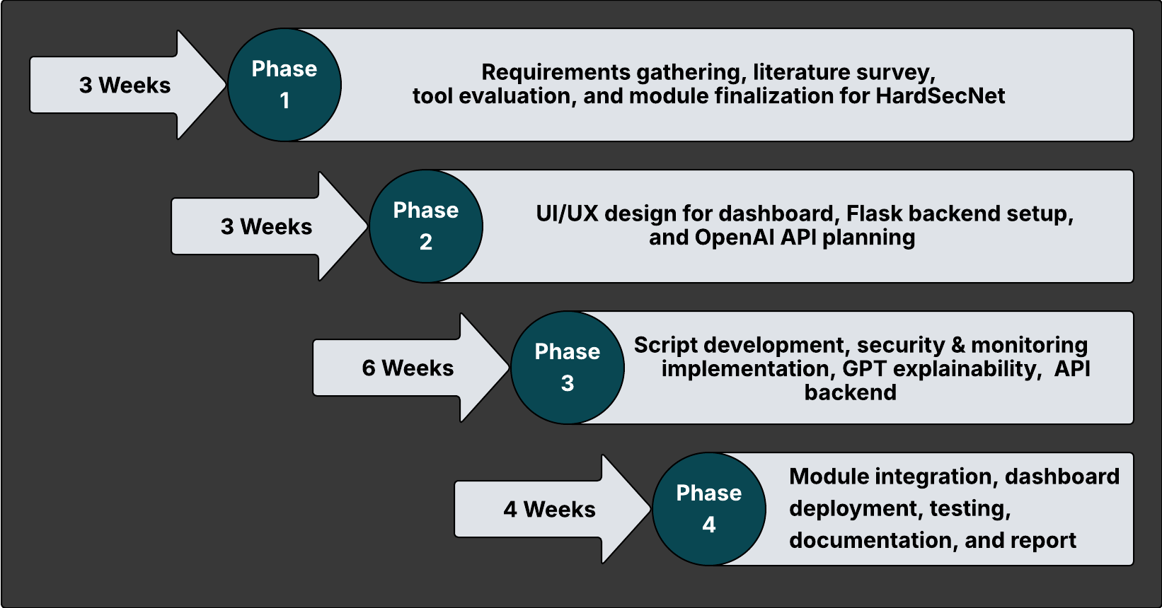
TIME LINE

Slide 9
PROJECT OUTCOMES
PO1: Engineering knowledge → OS security, GPT, audit tools
PO2: Problem analysis → config drift, weak policies
PO3: Solution design → HardSecNet platform
PO5: Modern tool usage → React, Flask, GPT, GitHub
PO6: Social relevance → Affordable cybersecurity
PO9: Team collaboration → Role-based milestones
PO10: Communication → Clear reports + dashboards
PO11: Lifelong learning → LLMs, dynamic policies

Slide 10
CO’S AND RELEVANT SDGS
CO1: Applied software engineering principles like modular design and agile methods to solve real-world cybersecurity problems.
CO2: Used modern tools—Flask, React, GPT APIs, GitHub, Postman, and Prometheus—for full-stack development and automation.
CO3: Designed system modules (audit, hardening, monitoring, explainability) based on clear functional requirements.
CO4: Analyzed audit results and performance logs to detect issues and drive continuous improvement.
SDG 9 – Industry, Innovation, and Infrastructure
HardSecNet promotes affordable and scalable cybersecurity solutions, encouraging secure infrastructure and innovation for industries and academia.

Slide 11
CONCLUSION
• HardSecNet addresses modern multi-OS security needs.
• Combines automation, AI, and usability.
• Suitable for real-world deployment.
• Encourages innovation in cybersecurity.

Slide 12
G
P
THANK
YOU

